Slide 1

Smart Traffic Fine Generation System
Presented by:- Guides:-
Dhruvkumar Patel (15CP049) [1] Dr. N.M Patel
Ketan Bhalerao (15CP050) [2] Prof. P.B Swadas
Monil Shah (15CP051)

Slide 2
Introduction
These days traffic is increasing at an alarming rate. This leads to uncontrollable traffic at crossroads. Moreover, certain rules have been incorporated by RTO which are necessary for maintaining public discipline.
However, a very practical fact proves that people these days hardly obey the incorporated rules which may result in severe accidents as well as society indiscipline.
This project aims to tackle these problems via a fully automated system which will track the moving vehicles on road and if a particular vehicle breaks a rule of surpassing crossroads while red light is on, the same vehicle’ s identity will be extracted through machine learning algorithms.
Later, after the identity of vehicle has been determined, an automated fine deduction will take place from vehicle owner’s account of which the user will be Mailed or texted.

Slide 3
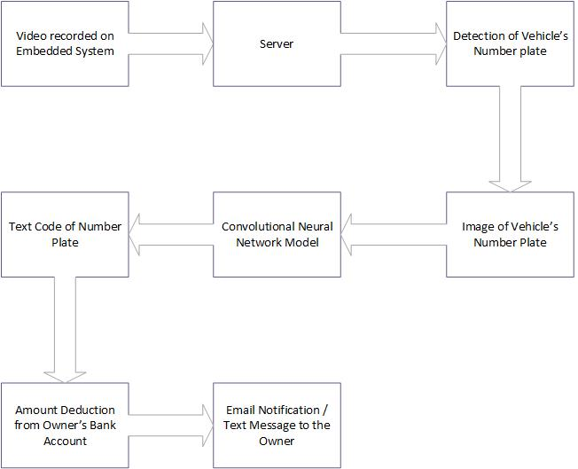
Project Flow

Slide 4
Project Outline
Record the video of moving vehicles
Separate the frames of received video
Remove the duplicate frames
Apply object detection algorithm for getting vehicle’s number plate
Apply CNN on number plate
Match the vehicle’s number in database
Send an email to owner of vehicle

Slide 5
Project Modules
Number Plate Detection
Number Recognition
Fine Generation through Email notification

Slide 6
Technologies to be utilized
Python 3.5 (Entire coding performed in Python)
CNN Modules: Keras ( Tensorflow as backend)
Image processing algorithms (For detecting number-plates)
MySQL Database
Image Processing libraries: OpenCV, PIL
Transfer Learning Model: Inception V3, VGG16, MobileNet
Google cloud platform (for training YOLO)
Python GUI library Tkinter

Slide 7
Project Tasks
Number Plate Detection Using the logic of edge detection.
CNN trained using MNIST dataset and various other machine learning platforms
Database normalized schema made ready in MySQL.
Prepared a GUI for displaying results and collecting dataset.
Prepared a dataset of number plates and their respective co-ordinates
Tried training YOLO for number plate detection over various cloud services as well as GPU.
Utilized ResNet50 model to detect car from the image.

Slide 8
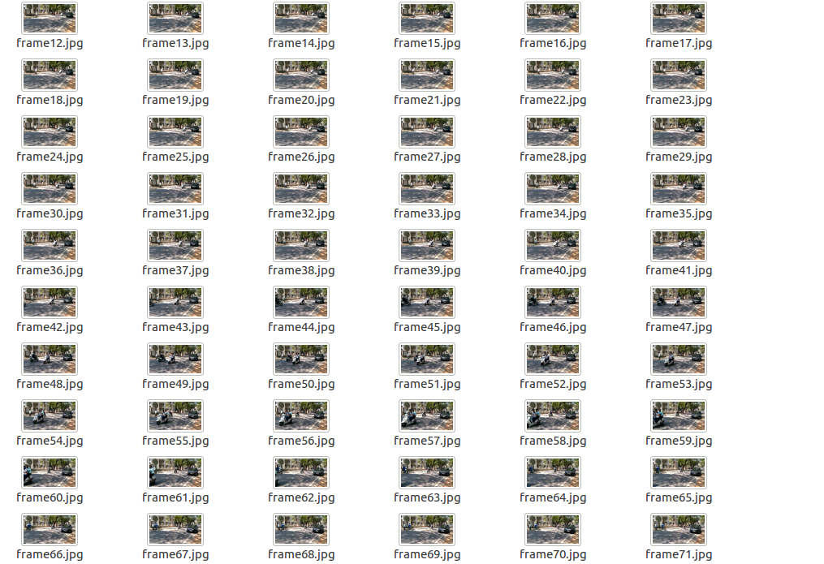
Video Processing

Slide 9
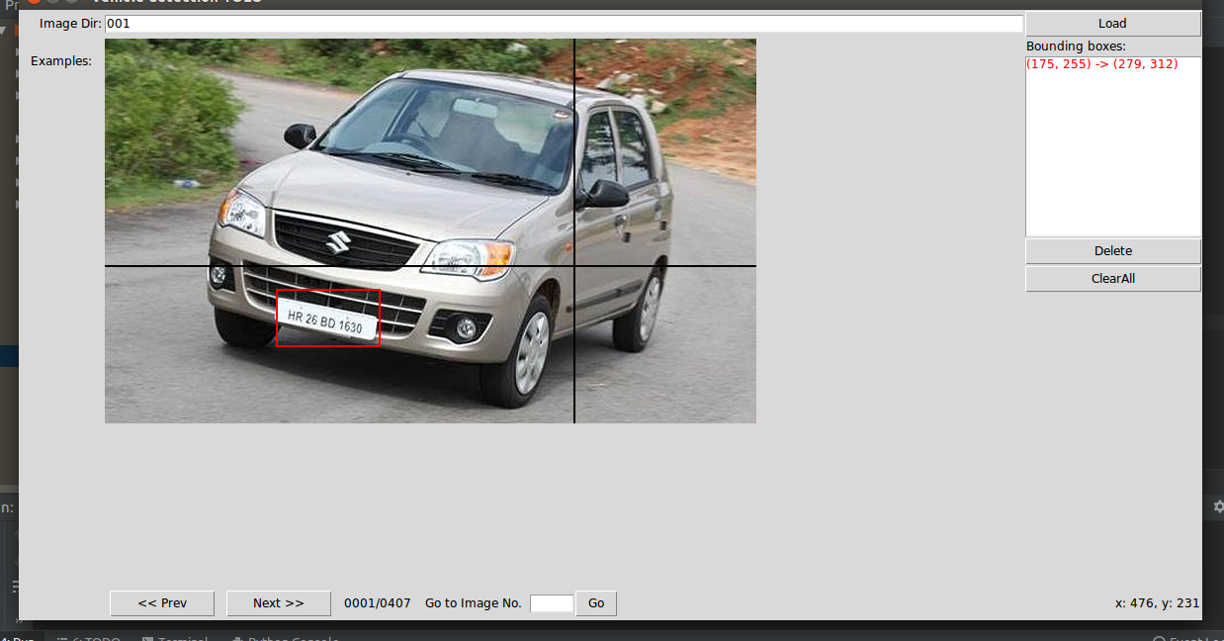
PREPARING GUI FOR CREATING DATASET OF YOLO OBJECT BOUNDING BOX FOR GENERATING VEHICLE’S NUMBER PLATE

Slide 10
Utilization of ResNet50 model
What if a captured frame has more than a single vehicle?
One possible answer: Separate out every vehicle from captured frame and feed every extracted image in iterative fashion to YOLO for number plate detection.

Slide 11
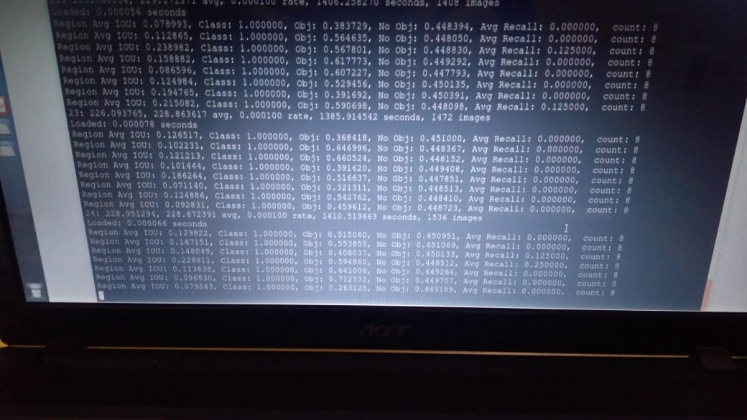
YOLO Training Iterations

Slide 12
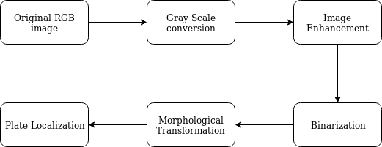
Number plate detection

Slide 13
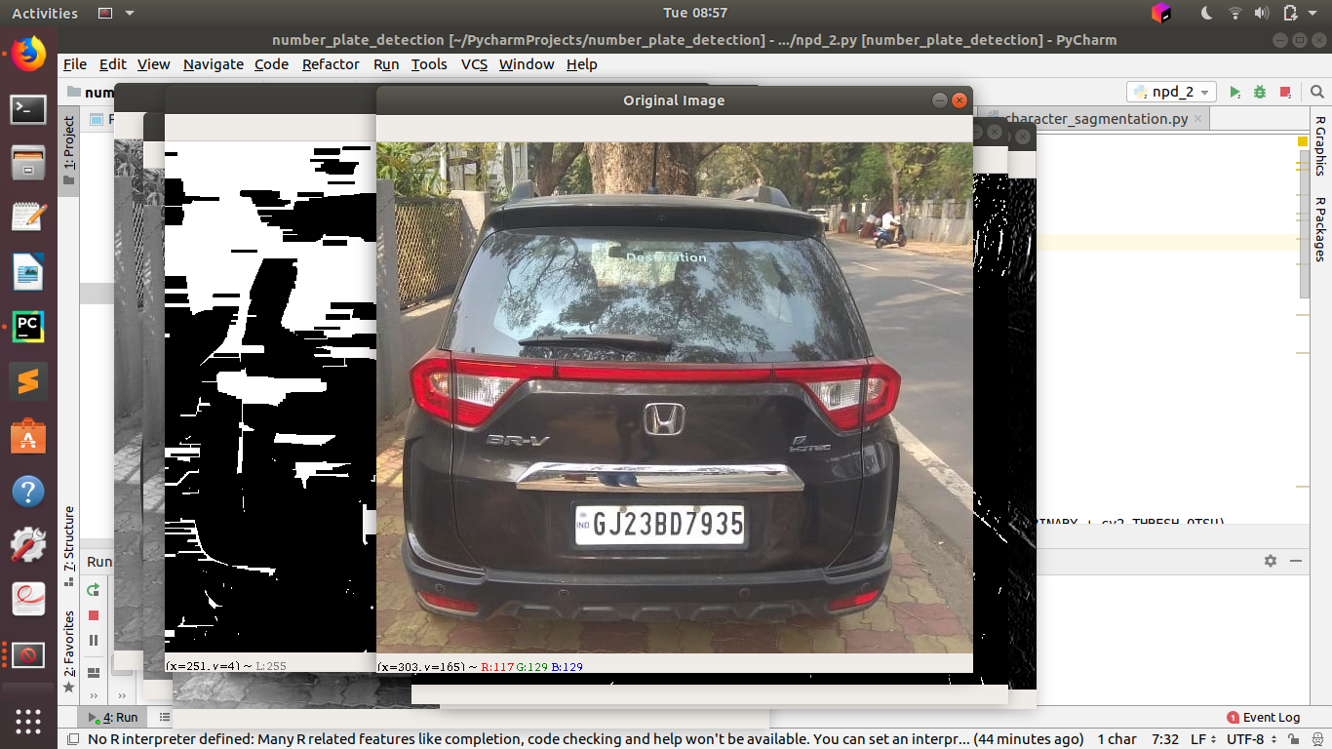
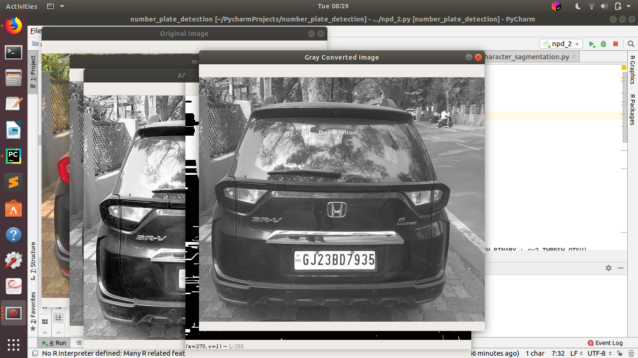
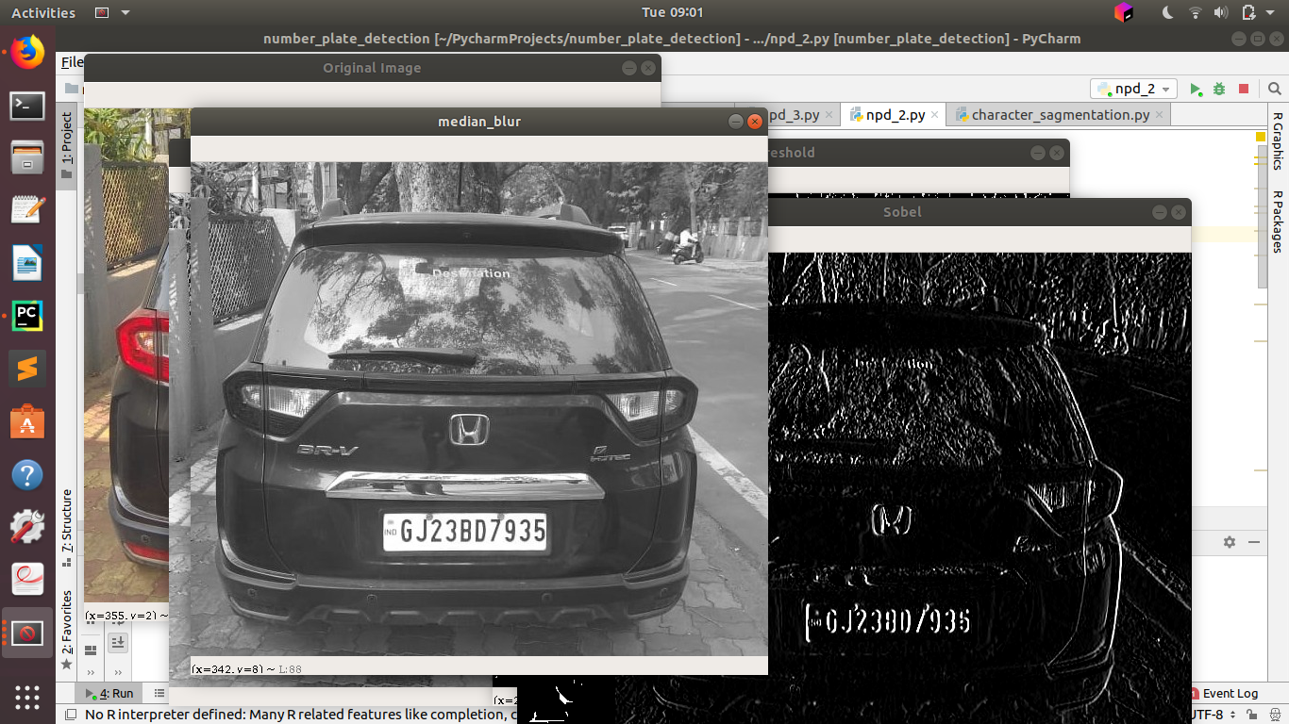
Original Image
Gray Scale conversion
Noise removal using median blur

Slide 14
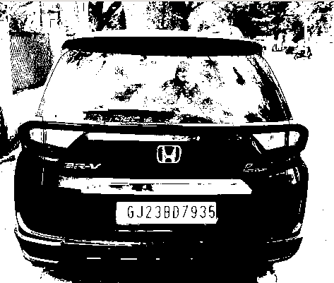
Image Binarization

Slide 15
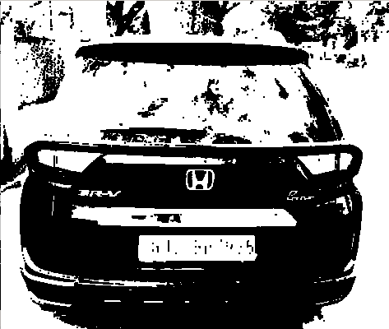
Morphological Transformation
(closing operation)

Slide 16
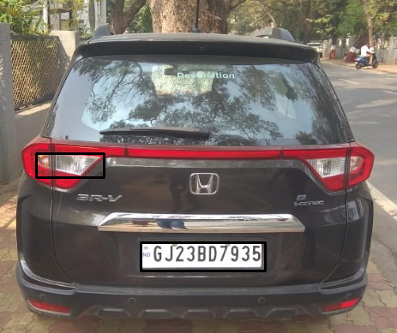
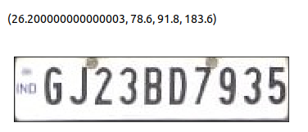
Image Contouring
Extracted Number Plate

Slide 17
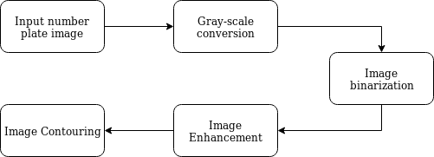
Character Segmentation

Slide 18
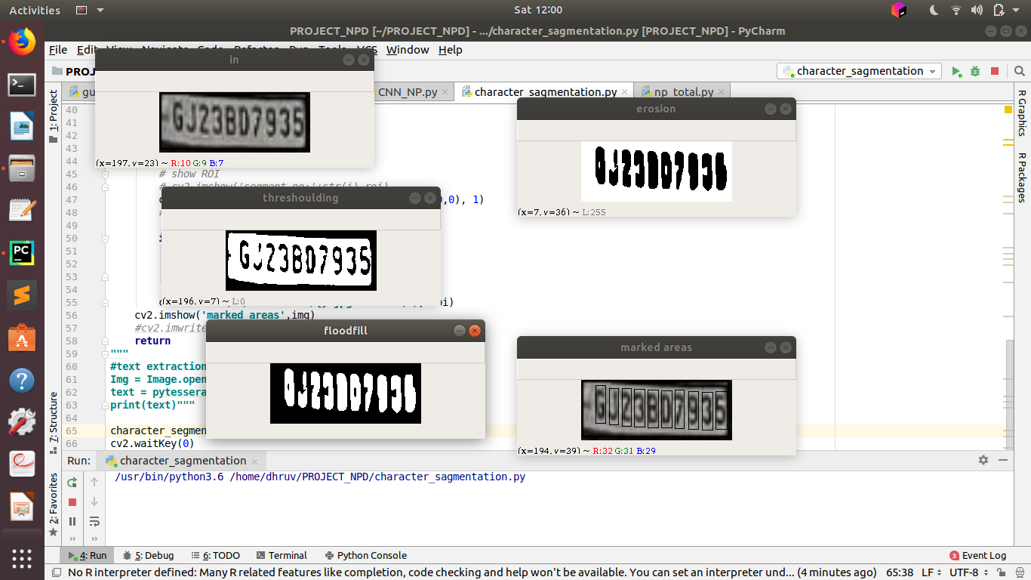
Sample Number plate
Image binarization

Slide 19
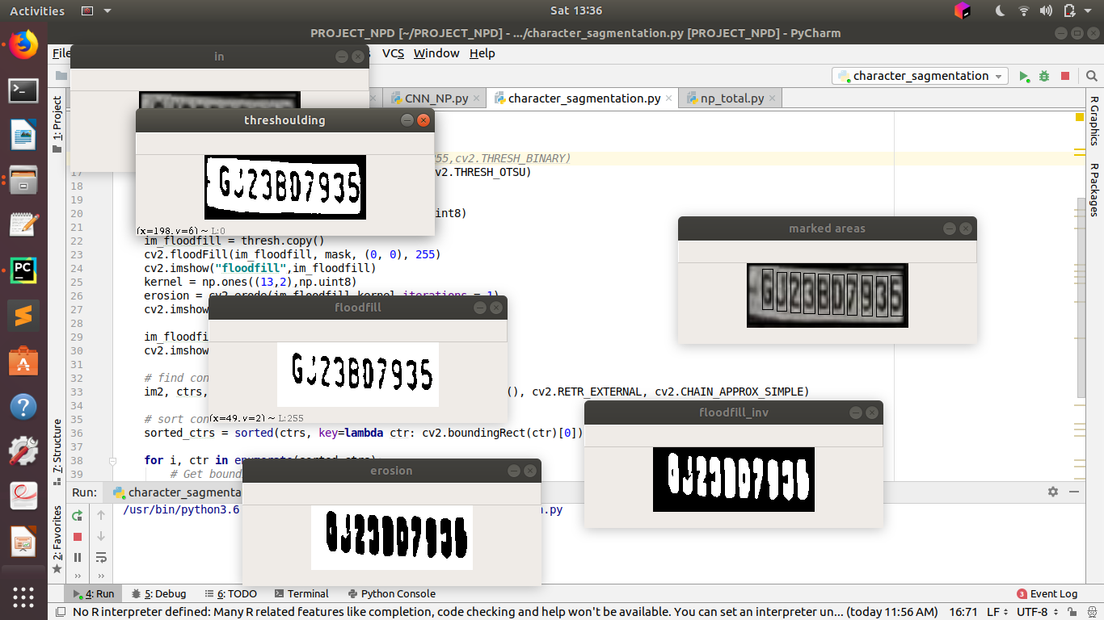
Image after applying flood fill filter
Image after applying erosion

Slide 20
Countoured number plate

Slide 21
Extracting number from the obtained number plate
Approach used: CNN
Achieved Accuracy till 1st midsem was 91.00% (trained from Scratch over 15,00,000 dataset images for 36 classes- 0 to 9 and A to Z)

Slide 22
A step towards Transfer learning
Following models were chosen to perform fine tuning over a subset of our original dataset:
1] Inception V3
2] MobileNet
3] VGG16

Slide 23
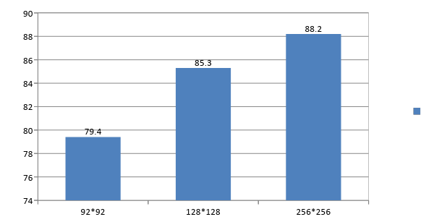
Accuracies over Inception V3
Accuracy
Image Size

Slide 24
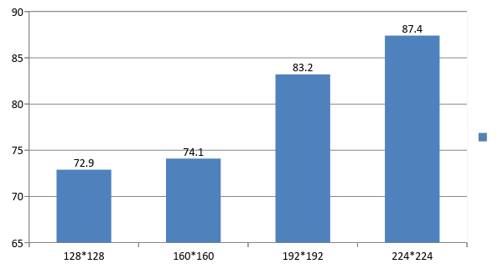
Accuracies over MobileNet
Accuracy
Image size

Slide 25
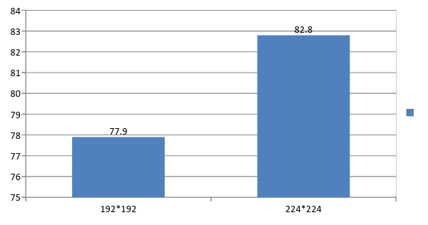
Accuracies over VGG16
Accuracy
Image size

Slide 26
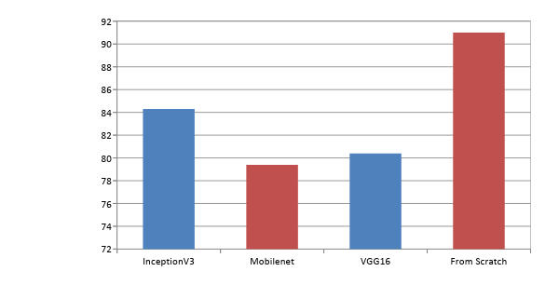
Overall Results
Avg. Accuracies
Approaches

Slide 27
Improving the model trained from scratch
Initial accuracy: 91%
Increased Neural Network’s body
Used LeakyReLU instead of ReLU
Decreased learning rate to 1e-4
Resulting Accuracy: 97.6%

Slide 28
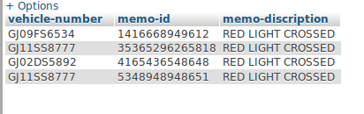
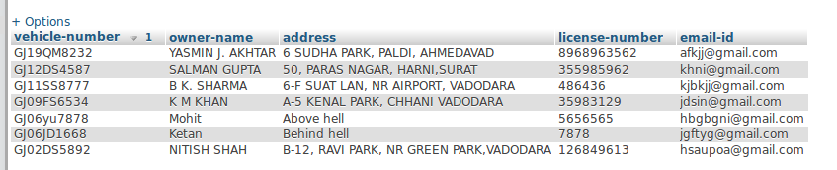
MEMO TABLE
VEHICLE OWNER DETAILS

Slide 29
Project Applications
It can used be to maintain discipline among public, thereby decreasing the risk of traffic accidents.
Man labor will be reduced thus leading to reliable system.
Digitization in traffic controlling system will prove as a push to digital India’s mission.
Transparency in fine collection will be improved.

Slide 30
Possible improvements
The image processing parameters which are currently static can be obtained through machine learning. Hence, the algorithms will adjust the parameters as per the image brightness, size, contrast and several other properties.
The CNN layers can be increased in order to bring the efficiency close to 100% for perfect recognition.
The quality of video camera can be improved in order to get better quality videos and hence, sharp images.
The entire system can be dumped into an embedded system for real time fine generation.

Slide 31
References
Ch. Jaya Lakshmi, DrA.Jhansi Rani, Dr. K. Sri Ramakrishna, M.Lantikiran, V.R. Siddhartha,”A novel Approach for Indian License Plate Recognition System”, IJAEST, Vol 2 Issue I, 2016, pp 010-014
Indian Vehicle Number Plate Detection Using Image Processing Swati Bhandari, Prof.Amit Kukreja, Sayali Bhatkar, Jyoti Chavda, Smita Lad International Research Journal of Engineering and Technology (IRJET), Volume: 04 Issue: 04 | Apr -2017
Introduction to GUI programming with Tkinter:
https://python-textbok.readthedocs.io/en/1.0/Introduction_to_GUI_Programming.html
Number plate detection on Indian car vehicles using YOLOv2 https://medium.com/@ravidesetty/number-plate-detection-on-indian-car-vehicles-using-yo2l2ov2-8c99e1a259f5
End-to-End Text Recognition with Convolutional Neural Networks Tao Wang David J. Wu Adam Coates Andrew Y. Ng
ImageNet Classification with Deep Convolutional Neural Networks by Alex Krizhevsky Ilya Sutskever Geoffrey E. Hinton University of Toronto

Slide 32
Thank You!

